Slide 1
The need to improve cybersecurity

Slide 2
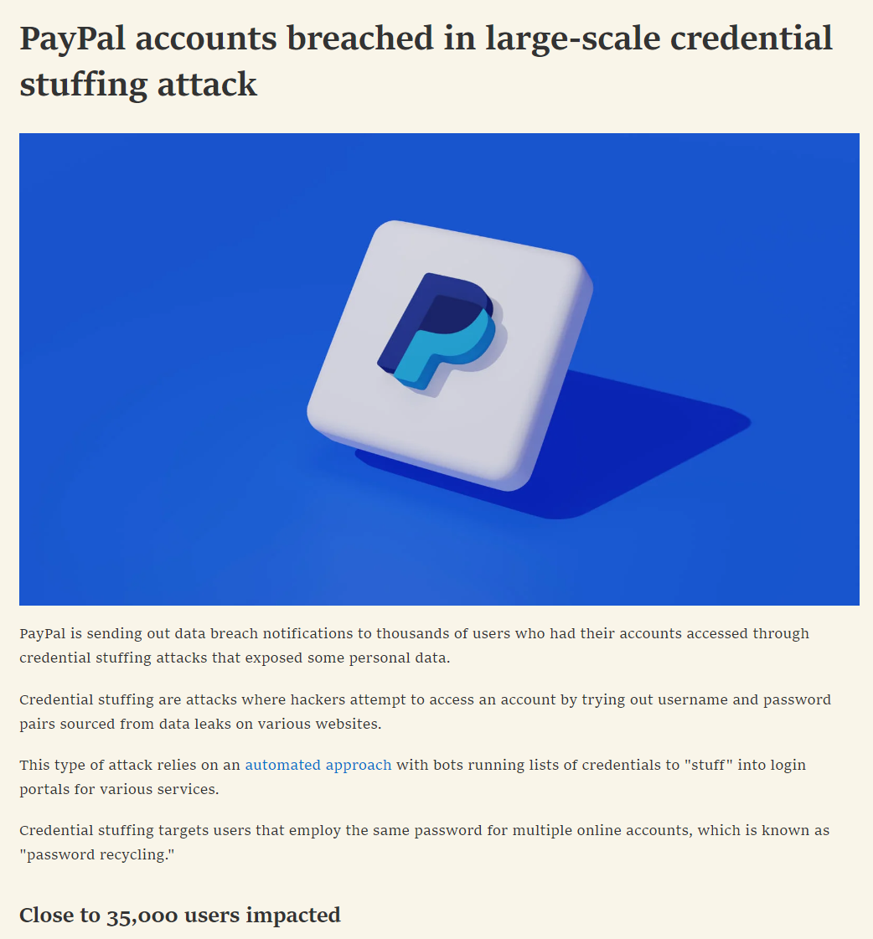
Nearly 35 000 users
Access to personal information:
  Social security numbers
  Connected debit/credit card information

Slide 3

What is cybersecurity?
Protecting data
Unauthorized access

Slide 4
Why do we need cybersecurity?
Trying to prevent attacks
User data protection

Slide 5
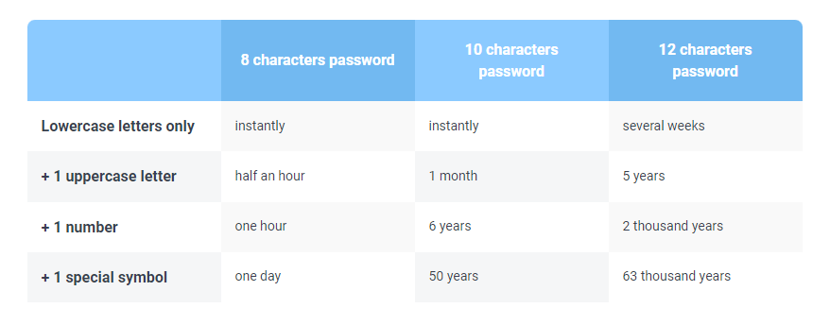
How to minimize the risk of cyberattacks?
Up to date software
Up to date antivirus software
Strong passwords

Slide 6
Summary
Cybersecurity ➔Protection of data
Minimize risk of attacks
  Up to date software
  Up to date antivirus software
  Strong passwords

Slide 7
Q&A
Now I will answer some questions

Slide 8
The end of my presentation

